Slide 1
EM algorithm
REPORTER：

Slide 2
Contents
01
Exponential of matrix
02
Different methods
03
Test each methods

Slide 3
Background
What is em, when solve with data has latent variable, like 一个例子 已知有身高数据，有男女性别，假设是服从正态分布， 但只有身高数据，性别数据未知，是latent variable此时怎么得到mu，sigma的估计

Slide 4
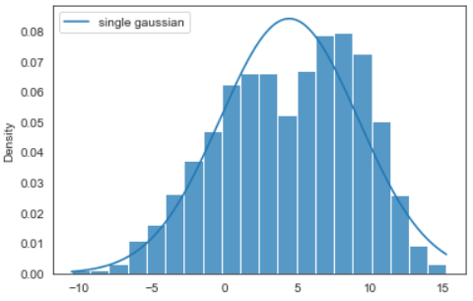
Background

Slide 5
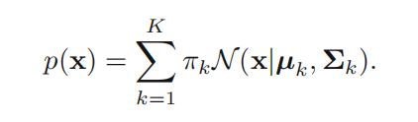


Mixtures of Gaussians
书430

Slide 6
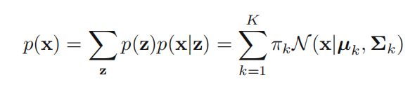
Goal

Slide 7
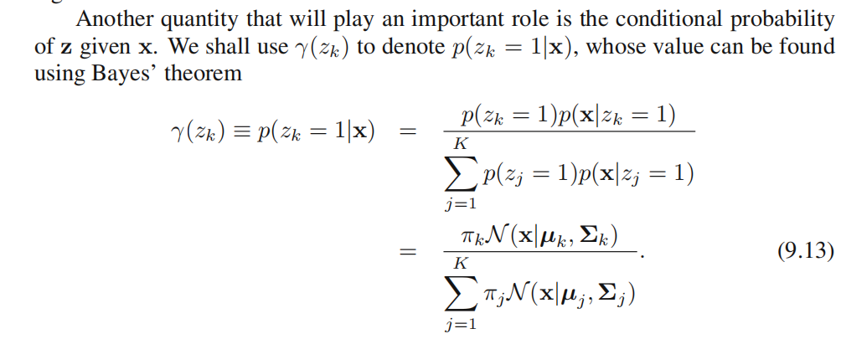
E-step

Slide 8
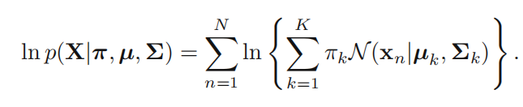
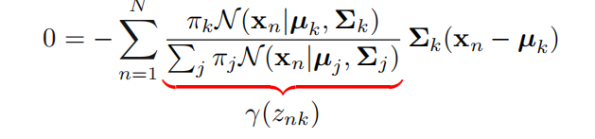
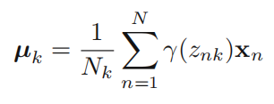
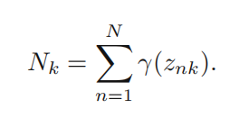
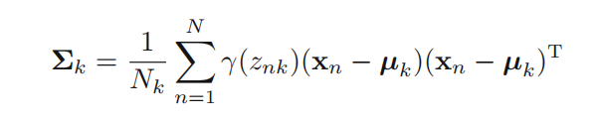

M-step

Slide 9
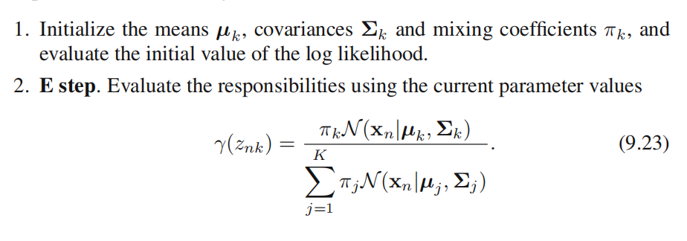
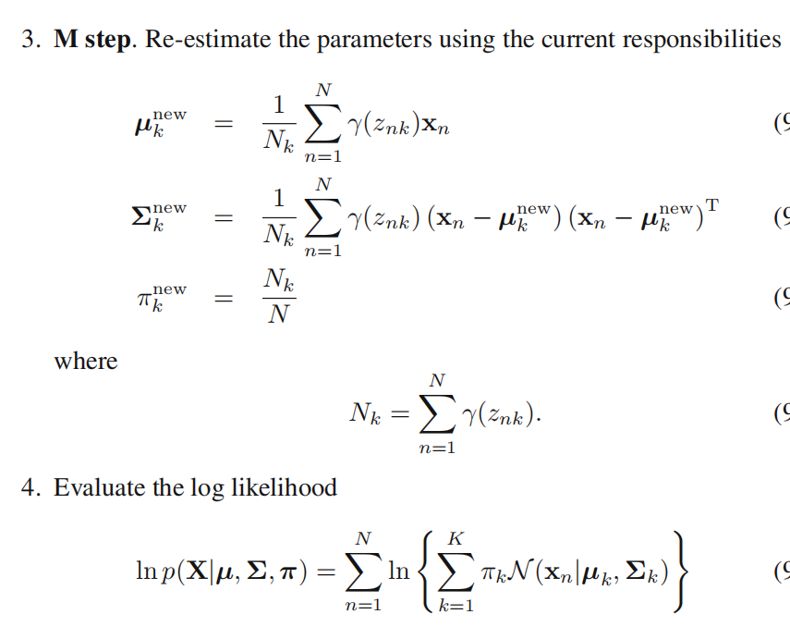
EM algorithm

Slide 10
画个流程图

Slide 11
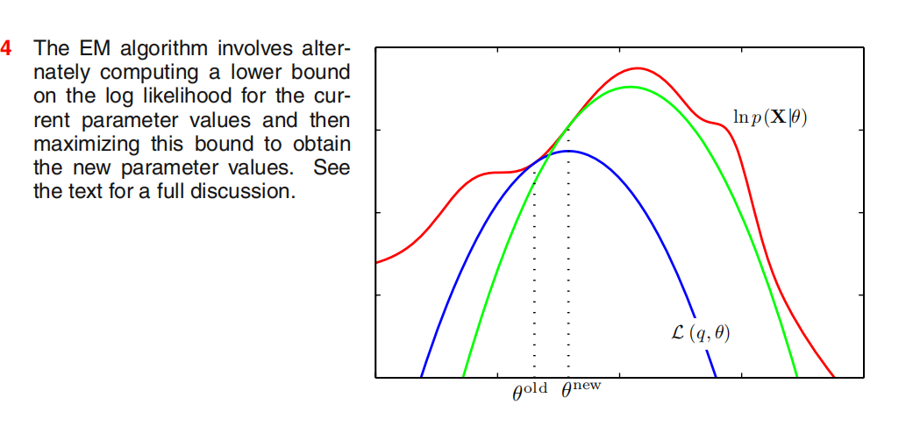
General case

Slide 12
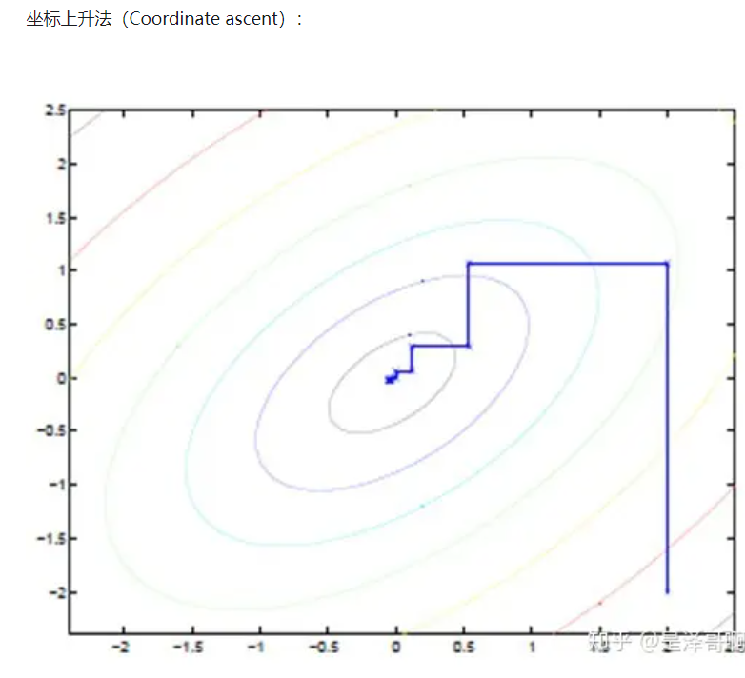
另一种naive思路

Slide 13
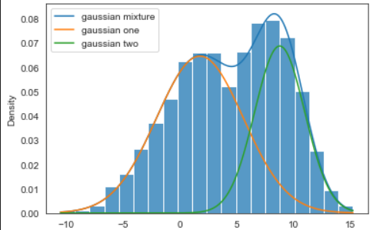
Application

Slide 14
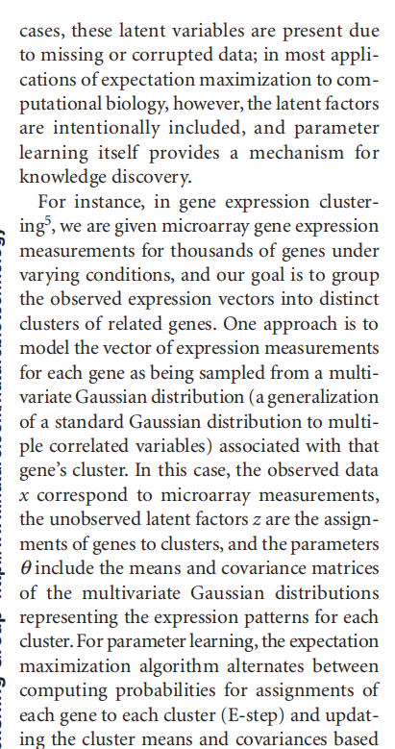
Application
paper

Slide 15
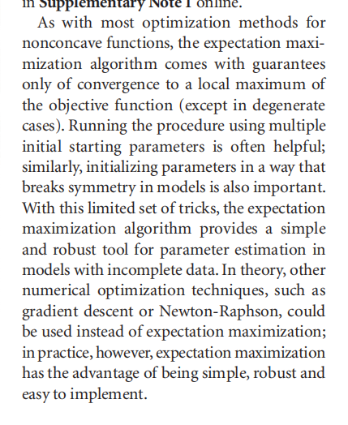
优缺点

Slide 16
Thanks

